Slide 1
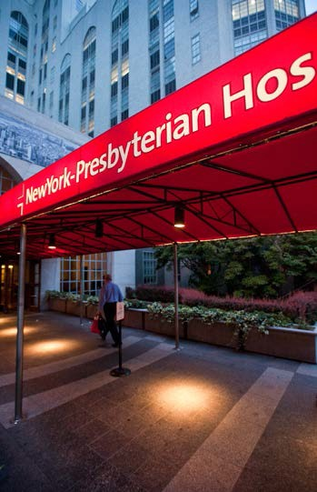

Pre-Op Education for Bariatric Surgery

Slide 2
Pre-Op Education
Designed to prepare patients and families for surgery and decrease stress
Helps patients and family to prepare for bariatric surgery
Helps patients understand their surgical procedure
Reviews the pre-operative evaluation requirements, admission process and hospitalization details
Familiarizes patients and families with the care team and their roles
YOUR PHYSICIAN’S INSTRUCTIONS TAKE PRIORITY OVER MATERIAL PRESENTED HERE

Slide 3
Table of Contents
Your Health Care Team
Preparing for Surgery
Pre-op Testing and Medical Clearance
Pre-op Medications
Pre-op Shopping List
Two Days Before Surgery
Preparing to Go to the Hospital
Important Paperwork
Advance Directives
Packing
What to Consider
The Day Before Surgery –
Guidelines and Suggestions
Day of Surgery
Day of Surgery Instructions
Post-Surgery
What to Expect after Surgery Pain Management
Feel Empowered
Discharge
Discharge Readiness Checklist Going Home
Home Instructions
Once You Are Home
Instructions and Guidelines

Slide 4
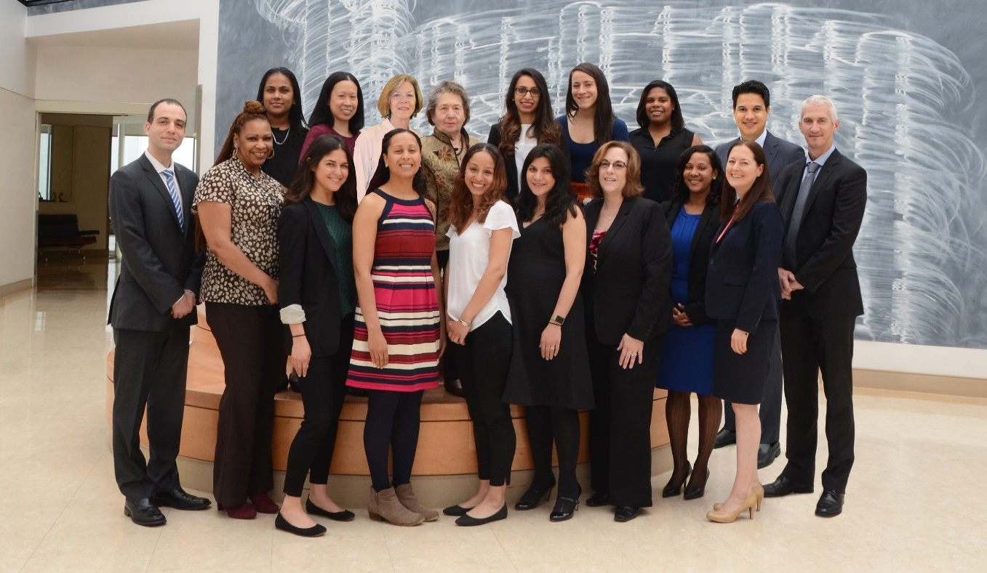
Your Health Care Team
Surgeon
Physician Assistant
Nurse Practitioner
Medical Secretaries
Unit Nurses
Nursing Assistants
Surgical Fellows and Residents
Medical Students
Social Workers
Dietitians
Medical Consultants
Others - Housekeeping, Lab Tech, Food Service Workers

Slide 5
Preparing for Your Surgery

Slide 6
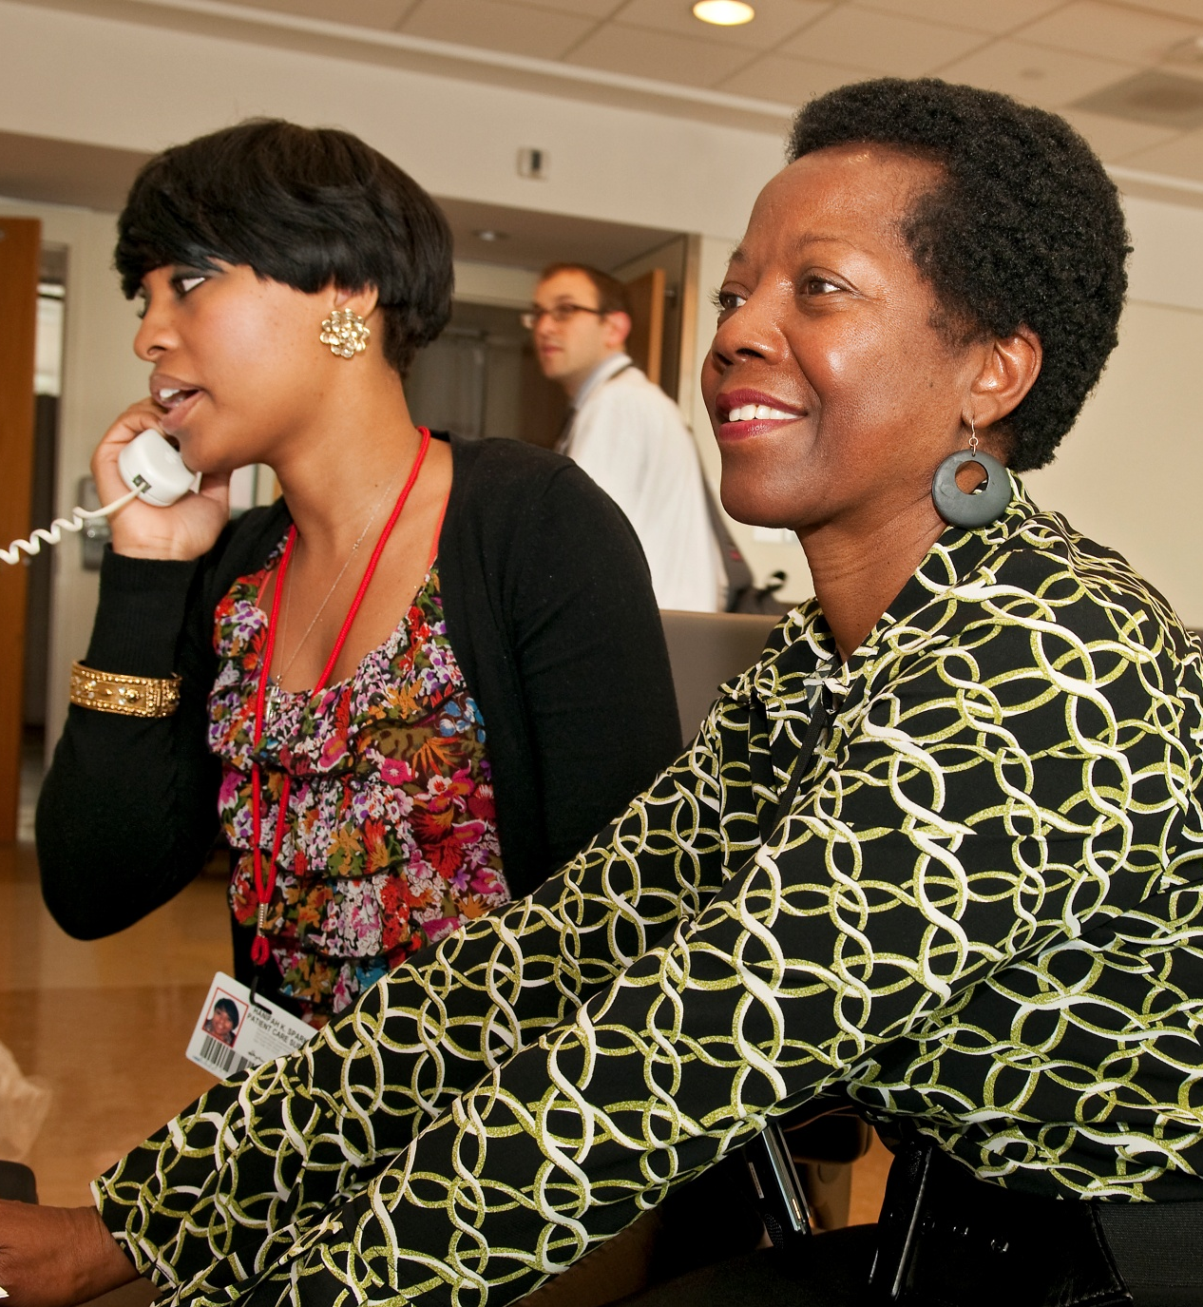
Pre-Op Testing
Pre-testing Location:
Greenberg 3 West
  No appointment necessary
  Walk-in basis ONLY
Your surgeon’s office will order the required testing and any additional tests PRIOR to surgery
Tests must be completed within 30 days of surgery

Slide 7
Medical Clearance
IMPORTANT
Medical clearance is required PRIOR to surgery
Your primary care physician must complete a medical history and physical examination within 30 days of your surgery

Slide 8
Pre-op Paperwork
Check with your employer’s Human Resources Department for medical leave or disability forms

Slide 9
Pre-Operative Medications
These are general recommendations. If you have any questions, please discuss with your doctor.
STOP Ibuprofen (Motrin, Advil), NSAIDS (Aleve, Relafen): 7 days prior to surgery
STOP Gout medications (indomethacin, colchicine): 7 days prior to surgery
STOP Glucosamine +/- Chondroitin: 7 days prior to surgery
STOP Vitamin E, Ginseng, St. John’s Wort, Garlic supplements: 7 days prior to surgery
STOP Glucophage / Metformin: 2 days prior to surgery
DISCUSS with surgeon when and if to stop: Aspirin, Coumadin, Pradaxa, Plavix, & other medications that affect clotting
DO NOT TAKE DAY OF SURGERY: Diuretics (also known as water pills). For example:
  Lasix / furosemide
  Hydrochlorothiazide (HCTZ)
  Aldactone / spironolactone
  Diovan
  ACE/ARB medications- see next page. . .

Slide 10
ACE/ ARB meds: do Not take day of surgery
Accupril (Quinapril), Accurectic, Aceon (Perindopril), Aliskiren, Aliskiren + Amlodipine (Tekamlo), Amlodipine/Aliskiren/Hydrochlorothiazide (Amturnide), Amlodipine Besylate Olmesartan Medoxomil) (Azor), Altace (Ramipril) , Amturnide (Amlodipine/Aliskiren/Hydrochlorothiazide), Atacand (Candesartan), Avalide (Irbesartan), Avapro (Irbesartan), Azilsartan Medoxomil (Edarbi), Azilsartan Medoxomil/Chlorthalidone (Edarbyclor), Azor (Amlodipine Besylate; Olmesartan Medoxomil), Benazapril, Benicar (Olmesartan), Benicar HCT, Candesartan, Capoten (Captopril), Capozide (Captopril-HCT), Captopril, Cozaar (losartan), Diovan (Valsartan), Diovan HCT, Edarbi (Azilsartan medoxomil), Edarbyclor (Azilsartan Medoxomil/Chlorthalidone), Enalapril, Eprosartan, Fosinopril, Hyzaar (Losartan-HCT), Irbesartan, Lexxel (Enalapril-Felodipine), Lisinopril, Losartan, Lotensin (Benazepril), Lotensin HCT, Lotrel (Amlodipine-Benazepril), Mavik (Trandolapril), Micardis (Telmisartan), Micardis HCT, Moexipril, Monipril (Fosinopril), Olmesartan, Olmesartan medoxomil (Azor), Olmesartan Medoxomil + Amlodipine + Hydrochlorothiazide (Tribenzor), Perindopril, Prinivil (Lisinopril), Prinzide (Lisinopril- HTZ), Quinapril, Ramipril, Tarka (Trandolapril/Verapamil), Tekamlo (Aliskiren + Amlodipine), Tekturna (Aliskiren), Teveten (Eprosartan), Teveten HCT, Trandolapril, Tribenzor (Olmesartan Medoxomil + Amlodipine + Hydrochlorothiazide), Uniretic (moexipril-HCT), Univasc (Moexipril), Valturna (Aliskiren and Valsartan), Valsartan, Vasotec (Enalapril), Zestorectic (Lisinopril-HCT) and Zestril (Lisinopril)

Slide 11
Pre-Operative Medications
These are general recommendations. If you have any questions, please discuss with your doctor.
Weight Loss Medications:
STOP Lomaira/Adipex/phentermine: 7 days prior to surgery
STOP Qsymia/phentermine-topiramate: 7 days prior to surgery, However, discuss with your prescribing physician as depending on your dose, you may need to decrease your dose gradually
STOP Contrave/naltrexone-buproprion: 7 days prior to surgery. Note if you are taking only bupropion, you should continue this up until surgery
CAUTION: Revia/Vivitrol/naltrexone: Please discuss with your prescribing physician, taking this medication may interfere with your surgery

Slide 12
Pre-Operative Medications
Insulin doses should be adjusted prior to surgery while on clear liquids, and also on the morning of surgery.
  - Please consult your endocrinologist or Primary Care Physician for appropriate dosing instructions.

Slide 13
Pre-Op Shopping
Review your “Dietary guidelines” packet along with suggested menus for when you get home from the Hospital.
Review your “Pre-op shopping list” and make sure you have the items listed before you go to the Hospital so that they will be available when you get home
Some important items on this list are:
Food processor/blender
Pill crusher
Protein shakes
Chewable multivitamins
Calcium with vitamin D

Slide 14
Two Days Before Surgery
No solid foods after midnight two days before surgery
  Example: If surgery is scheduled for Monday, on Friday at midnight, you will begin your CLEAR LIQUID DIET, and continue with clear liquids all day Saturday and Sunday
Drink plenty of clear liquids to prevent dehydration, such as
  water, tea, coffee (no milk, cream, or non-dairy creamers; sugar substitute is ok) seltzer, clear diet soda, broth / bouillon, diet/sugar free Jello (not pudding), and diet/ sugar free popsicles, ices, or sorbet, and diet drinks such as Crystal Light, Diet Snapple. No alcohol.
In addition to the above, unlimited fluids, you must consume carb-loading (“sugar”) drinks on the night before surgery and AGAIN the morning of surgery. Finish your 2nd drink before you get to the hospital. Choose from:
ClearFast (CF) Preop: 12oz (1 bottle) 2x: the night before & the AM of surgery
Ensure Pre-Surgery Clear Carbohydrate Drink: 10oz (1 bottle) 2x: the night before & AM of
Gatorade Prime: two 4oz pouches, so 8 oz 2x: the night before & AM of
Cranberry or Grape Juice: 24 oz the night before, 12 oz the AM of surgery
Apple Juice: 32 oz the night before, 16 oz the AM of surgery

Slide 15
Preparing to Go to the Hospital

Slide 16
What to Bring to the Hospital
Important Paperwork
Medical Insurance information
  On day of admission & for pre-operative testing as well
A LIST of all your current medications, including dosage and frequency:
    Prescriptions and over-the-counter medications
    Vitamins
    Herbal supplements
List of all Allergies (medications, latex, food, etc.)
A Photo ID, such as a driver’s license or passport
List of telephone numbers for your contacts

Slide 17
Other Important Paperwork
Advance Directives
What They Are:
Documents that plan your wishes about treatment if you become unable – for a short or long period – to decide for yourself
If you do not have an advanced directive, you can complete the necessary paperwork the morning of surgery
Types:
Health Care Agent / Proxy – A person appointed by you who will protect your treatment wishes
Living Will – A document with written instructions given by you about your specific treatment desires

Slide 18
What to Bring: Packing
Do Bring
Personal toiletries (toothbrush, comb, soap etc.)
Slip-on slippers (non-skid sole)
Socks
Loose roomy outfit & underwear to wear home
Comfortable shoes to wear home
Soft sports bra
Cell phone (if desired)
Roomy bathrobe (only if preferred - we recommend using our gowns)
Books, magazines, crossword puzzles
If you use a CPAP Machine, please bring only your mask
Reading glasses
Face mask
Do Not Bring
Money
Jewelry or other valuables
Your medications from home
Electrical appliances (i.e., hairdryers, other plug-in items)
For a complete list, please refer to the NewYork-Presbyterian Preparing for Your Stay Guide

Slide 19
What to Consider
Visiting Hours: Usually 9AM- 9PM. Check current Covid-19 guidelines
Parking Validation available for day of discharge
Private Duty Nursing: Call (212)746-4091
Private Room: Call Admitting Department (212)746-4250
Guest Facility at Helmsley Medical Tower: Call (212)472-8400

Slide 20
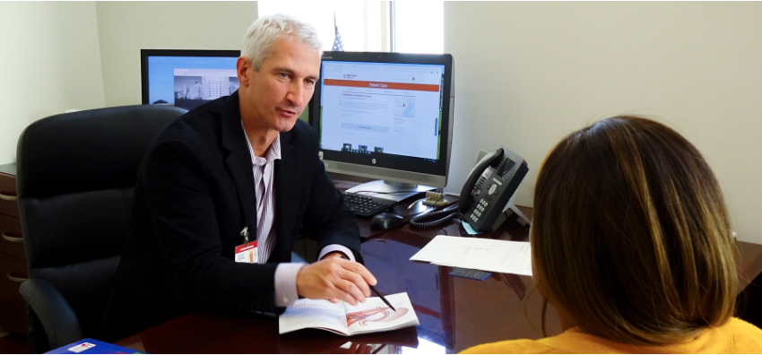
The Day Before Surgery
3 West (or Pre-op Surgery) will call you the day before surgery to give you arrival time and location
For Monday surgeries, you will be called on Friday
If you do not receive a call, you may call 3 West/Pre-op Surgery: (212) 746-5299 between 4 pm – 6 pm for your arrival time.

Slide 21
The Day of Surgery

Slide 22
The Day of Surgery
At your scheduled time, report to:
NYP/Weill Cornell Medical Center
525 East 68th Street
Greenberg 3 West
Same Day Surgery Center
Personal belongings will be collected on 3W and then taken to your room once it is assigned
Family may stay with you until you go to Operating Room (OR)
A Family Waiting Room is on the same floor as the OR
The Liaison Nurse will provide updates to families during the surgery
The surgeon will speak to your family after surgery

Slide 23
The Day of Surgery
While we always do our best to be on time, unexpected delays in the operating room schedule may occur.
Your patience is greatly appreciated.

Slide 24
What to Expect After Surgery

Slide 25
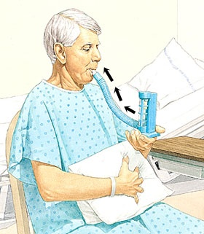
What to Expect After Surgery
Within a few hours of your surgery, you will begin to sip water and clear liquids.
Large pills will be crushed in order for you to take them safely
You will be given an incentive spirometer to encourage deep breathing after anesthesia
Expect to spend 1 night in the hospital

Slide 26
What to Expect After Surgery
Expect to get out of bed with assistance within 6 hours after surgery
Slowly increasing activity (as your pain allows) is important for your recovery
Your vital signs will be checked multiple times after surgery to ensure that
you are recovering safely
You will also be seen daily by members of the bariatric surgery team
Your attending surgeon will approve all care provided

Slide 27
Feel Empowered

Slide 28
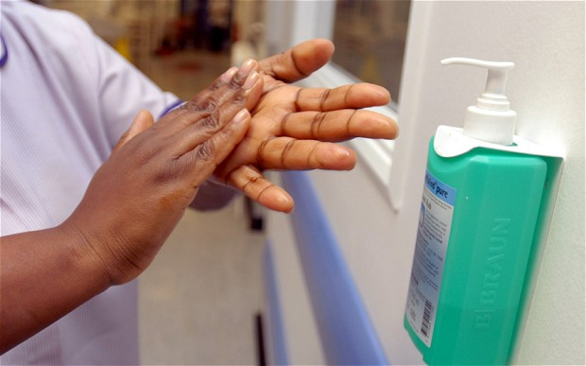
Feel Empowered
All personnel should identify themselves. If they do not, ASK.
All personnel should wash their hands with soap or Purell upon entering your room. If they do not, ASK.
Before any testing and administration of medications, staff will confirm your identity. If they do not, ASK.
Masking as per current Covid-19 hospital guidelines

Slide 29
Discharge

Slide 30
Discharge
In Most Cases, You are Ready for Discharge When:
Your vital signs are stable, including blood pressure, heart rate, and temperature
Your pain is controlled with oral pain medication
You are able to drink adequate amounts of liquids without difficulty
You are passing gas or have a bowel movement
You are able to get in and out of bed with minimal assistance
Your doctor will make the final decision regarding when you are ready for discharge.

Slide 31
Going Home
Questions to Consider:
Who will take me home from the hospital?
How will I get my prescriptions filled?
Do I have my chewable vitamins, protein shakes, and pill splitter/crusher at home?
Appointments to Make
  Call your doctor’s office before you leave if you do not already have your 3-week follow up appointments with BOTH your surgeon and nutritionist scheduled.
Continue bariatric surgery follow up visits with your surgeon and nutritionist at the 3 month, 6 month,
and one year mark, and once every year thereafter

Slide 32
Home Instructions
You can take small pills (approximately the size of a dress shirt cuff button) whole
You must either crush large medications with a pill crusher, or split or crumble them into button-sized pieces, then take them with a spoon of a clear or full liquid (eg Diet Snapple ®, yogurt, blended soup)
Peel the small tapes (“Steri-strips”) off of your incisions after 2 weeks
No baths, no swimming
No heavy lifting (10 pound limit)
No gym workouts – only walking until cleared by your surgeon
No driving until you are off of prescription pain medications
Climbing stairs is allowed
If you are allowed to shower, pat surgical area dry, do not wipe or rub area
Most return to work in 2-4 weeks

Slide 33
Home Instructions
Contact your surgeon’s office if you experience
any of the following symptoms:
Fever > 101.5º F
Severe Nausea / Vomiting
Inadequate Pain Control
Diarrhea with Abdominal Cramps
Constipation
Redness/Drainage from your Incision
Swelling and/or pain in one leg or calf
Unable to drink at least 32 oz of liquid per 24 hours

Slide 34
Once You Are Home
If You Have Any Questions or Concerns Once You Return Home,
Call Your Surgeons Office:
(646)962-8462
Remember
Please follow specific instructions from your surgeon’s office; they supersede any material presented in these slides.

